Slide 1
Applied Data Science and visualization 2024
Lecture 6 John Shorter

Slide 2


What did we learn last time?
We can set up a block design and control for variation
We can test for interactions using ANOVAs

Slide 3
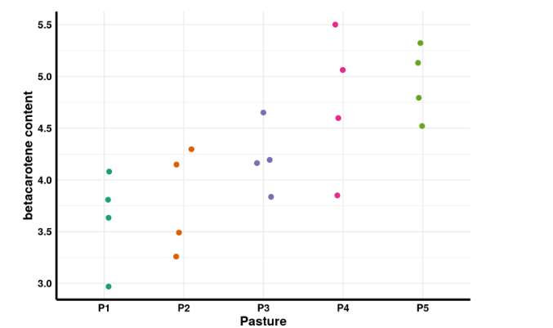
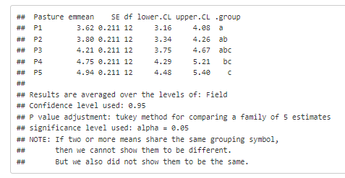
Nice examples with blocking factors
This allows us to report the main effect (Pasture) while averaging over the levels of Field.
Very important if we are trying to ‘control’ for a variable.

Slide 4
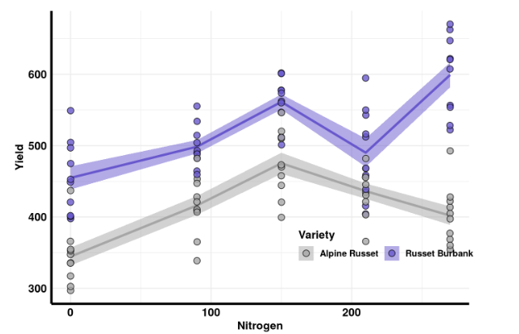
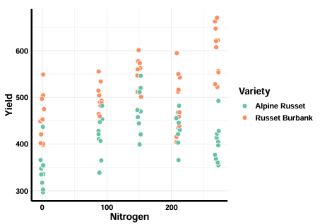
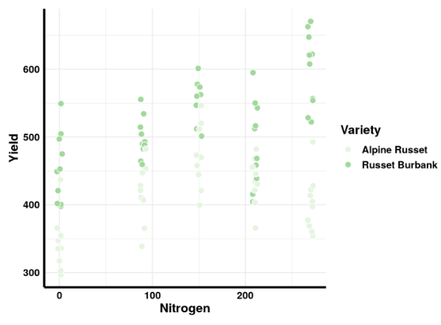
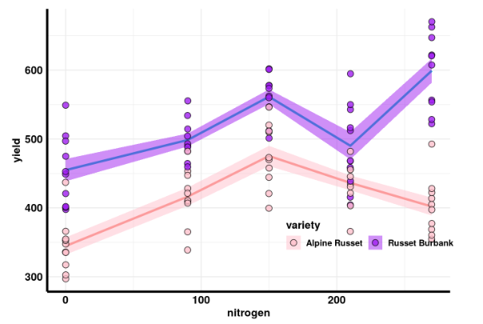
Nice examples from the homework

Slide 5

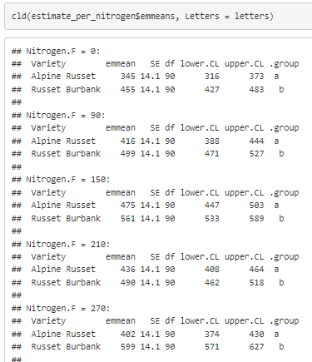

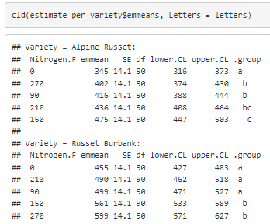
Nice examples from the homework

Slide 6
What are we going to do today?
We are going to work with correlations and regressions, which is important if we are comparing numeric to numeric data
We will work through proportions and enrichments. This is primarily used if we are comparing categorical data to other categorical data. Chi-square tests are helpful!
We will spend the rest of the time on mini-projects. Make sure your project is put on the shared excel sheet before you leave!
In the next class (April 3), we will discuss logistic regression. That is where an outcome is 0 or 1, or case and control. Plus, a little more time for mini-project work.

Slide 7
Let’s get started on ucloud

